Slide 1
Minimizing Crime Rates Through Budgetary Decisions
Logan DeSmet

Slide 2
Problem: Crime and Budget Decisions
Thinking that crime is a way of measuring police effectiveness is only addressing a fraction of what really influences crime
Crime is influenced by population profiles and statistics
Population profiles and statistics are influenced by budgetary decisions
Goal: Optimizing budget decisions to minimize crime rates
So future budgetary decisions can be made with data driven insights
FBI: “It’s important to consider the various factors that lead to crime activity and crime reporting in a community before interpreting the data. Without these considerations the available data can be deceiving. Factors to consider include population size and density, economic conditions, employment rates, prosecutorial, judicial, and correctional policies, administrative and investigative emphases of law enforcement, citizens’ attitudes toward crime and policing, and the effective strength of the police force.”

Slide 3
Data Sourcing
---------------------------------------------------------------------
Crime data: FBI: Crime Data Explorer
----------------------------------------------------------------------
Population Profile Data: ACS Population Profiles (2010-2021, no 20)
----------------------------------------------------------------------
Budget Data: 2020 Budget Data - census.gov
---------------------------------------------------------------------

Slide 4
How Can This Be Optimized? (Key Assumptions)
Budget Data from Census.gov is broken into these official categories:
Education Services | Social Services and Income Maintenance | Transportation | Public Safety | Environment and Housing
Education, Libraries | Public Welfare, Hospitals, Health, Employment Security, Veterans’ services | Highways, Air Transportation, Parking Facilities, Sea and Inland Port Facilities | Police Protection, Fire Protection, Correction, Protective inspection and regulation | Natural Resources, Parks and Recreation, Housing and Community development, sewerage, solid waste management
Governmental Administration | Interest on General Debt | General Expenditure, n.e.c. | Utility Expenditure | Liquor Store Expenditure | Insurance Trust Expenditure
Financial Administration, Judicial and Legal, General Public Buildings, Other governmental administration | Interest on General Debt | Miscellaneaous Commercial Activities, Other and unallocable | Water supply, electric power, gas supply, transit | Liquor store expenditure | Unemployment Compensation, Employee Retirement, Workers Compensation, Other insurance trust
(i.e. Education Services = Education + Libraries)

Slide 5
How Can This Be Optimized?
Education Services | Social Services and Income Maintenance | Transportation | Public Safety | Environment and Housing
Governmental Administration | Interest on General Debt | General Expenditure, n.e.c. | Utility Expenditure | Liquor Store Expenditure | Insurance Trust Expenditure
“Interest on General Debt” and “General Expenditure, n.e.c” are not adjustable - that part of the budget is predetermined
The model combined these into a variable called “Other Expenditures”, and must take the value as a constraint

Slide 6
Calculations In the Model
All the data was combined from 2015-2021 (no 2020)
Crime data = Violent Crimes + Property Crimes
Budget data was converted to proportions of total budget
Crime data was converted to crimes per resident
Population Profile data was converted to proportions of population
Key Assumption: State residents act in similar ways (crime) with similar population profile data
Model does not account for the difference culturally

Slide 7
Calculations in the Model (cont.) - Python
A Neural Network was used to calculate feature importance among the population profile data points to predict crime rate
The top 10 most important features were selected
The selected population profile features were then used in a Linear Regression Model to predict violent crime rate and property crime rate separately
The budget category features were then used in a Linear Regression Model to predict each of the selected population profile features separately
The weights (coefficients and intercepts) from each model were then extracted and put into functions to use for the optimization model
With scaling when necessary

Slide 8
The model performance
The output of the machine learning model crime rate predictions were impressively extremely accurate
All crime rate predictions were within 0.001 of the expected true rate
Suggesting that culture does not make too large of an impact
The optimization model had some key assumptions:
Only allowed budgetary decisions within the range of possible values in the dataset → this way the budget was spread around
Accepted a minimum crime rate of 0.01 → it would be unreasonable to predict a crime rate of 0
The budget total input into the model should not include Direct Expenditures (which was not one of the categories listed on slide 4) → the reason being this funding is split between national and state funding, and does not change much by state
So with total budget of $1million, and direct expenditures of $200k → model input is $800k

Slide 9
Key Challenges When Optimizing
Inorder to scale the decision variables and work through the Machine Learning algorithms, the optimization model required some intense coding – something outside of this course
In Summary: The decision variables needed to be set to 0 at the start of the model, and then optimized with the constraints mentioned on the last slide
The model was then solved and optimized using ‘cbc’
Then instances of the model were made for each ‘client’ and a constraint was added for said client’s ‘Other Expenditures’ category (Interest on General Debt” + “General Expenditure, n.e.c”)

Slide 10
The (Hypothetical) Client
The optimization model was used for every state’s 2021 budget
With each state’s corresponding “other expenditures” being considered a constraint
2022 and 2023 are simply not available yet (2022 is available Jan 1)
Every state was optimized and added to a dictionary
A user can call the function at the end of the python model specifying the state and get both the state’s optimized budgetary proportions and dollar amounts
The user simply inputs the datafile where specified and the model does the rest
Summarized on the next slide...

Slide 11
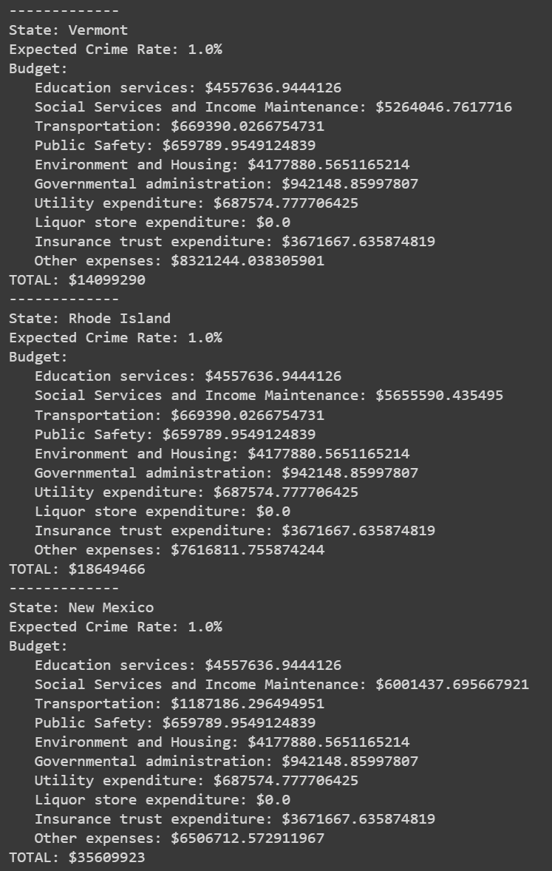
Optimized State Budgets (for 2021)
The full output of optimized budgets is in the optimization model results (python file)
The output for 3 states →
Interesting Finds:
Every State maxed out ‘Education’, ‘Public Safety’, and ‘Environment and Housing’
The other budget categories all varied by state
Suggests the most important things for crime rate
Suggests that more funding should be put into these categories beyond what is currently the maximum found in the data

Slide 12
Conclusions and Projected Benefits
‘Education’, ‘Public Safety’, and ‘Environment and Housing’ are the most influential factors on expected crime rates
Every state maxed out the amount they could allocate to these budgetary categories
This suggests that the government currently is spending too little on these categories and more funding should be put in place
With less funding limitations the optimization model should be rerun to produce better results
Of the 10 most important features identified from the Neural Network: ‘health insurance coverage’ and ‘Proportion of Population above 25 with no Highschool degree’ both aline with these most influential factors
Suggesting that these should be heavily considered when making budgetary decisions

Slide 13
Limitations and Next Steps
As discussed throughout the presentation, the most important limitation is the lack in the model to identify cultural impact on crime rates – a metric that varies state to state
Considering accuracy of the model, it likely minimizes this cultural effect
Next Steps:
Further incorporate model with less maximum budgetary constrictions → allowing for budget to be allocated higher than what we saw in the dataset
This requires research on what the proper minimums are for each budget category
Add a way for users to highlight and constrain certain population profile metrics, not selected by Neural Network
i.e. Higher Education Percentage

Slide 14
Supporting Files
Transforming the data from the raw data files into data that was applicable for the model took 20+ hours of coding and tableau prep work (a lot of trial and error)
The supporting folder includes read me files which walk through the steps of converting the data
Specifying the appropriate python and tableau prep file for each step

